Slide 1
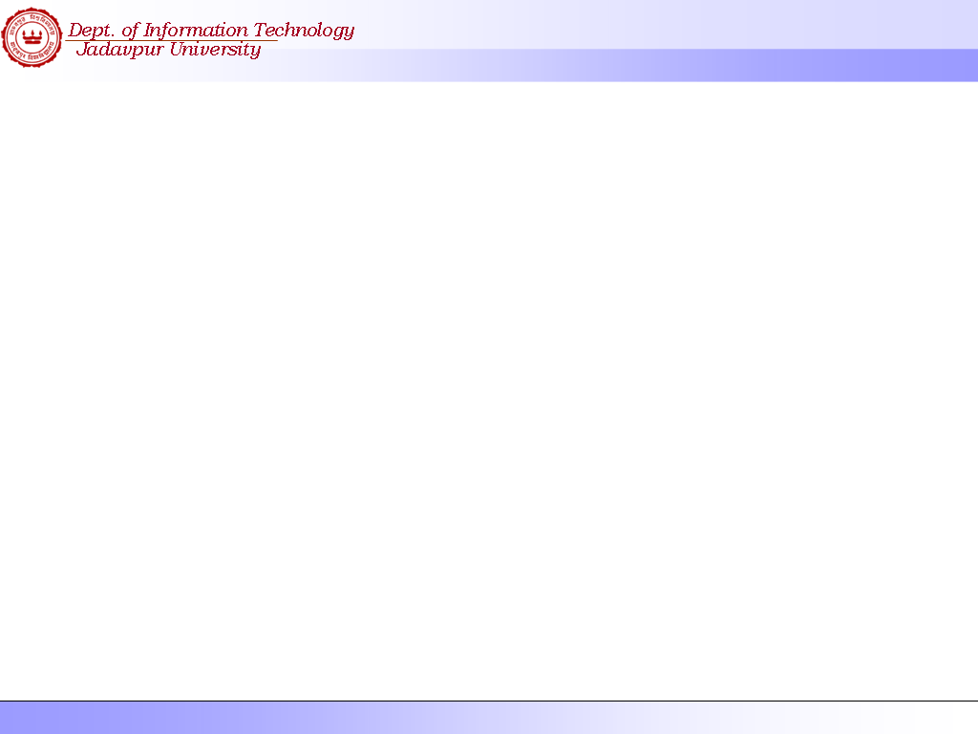
Interface
Design

Slide 2
The user interface
System users often judge a system by its
interface rather than its functionality
A poorly designed interface can cause a user to
make catastrophic errors
Poor user interface design is the reason why so
many software systems are never used
Most users of business systems interact with these systems through graphical user interfaces (GUIs)
In some cases, legacy text-based interfaces are still used

Slide 3
Interface Design
3 kinds of Interface Design
Interface with existing systems and entities.
Interface among different S/W Components.
Interface with Human Interface
( which is our interests )

Slide 4
Interface Design
3 kinds of Human Computer Interface
Legacy system human Interface ( through Dumb Terminal using commands and forms )
Modern PC Interface ( through GUI using pointing device )
Embedded system Human Interface ( example; Cell Phone, PDA etc. )
Our Interest lies in the 2nd one.

Slide 5
Interface Design
Interface Design Activities
Users Profiling
User Task Analysis
Defining Screen Layouts, Interface Objects and actions
Design Evaluation
If necessary prototyping can be done.

Slide 6
Interface Design
Interface Design Activities
User Profiling
What kind of users will be using the system ?
Whether the users are novice or knowledgeable ?
What is the frequencies of usage ?
What will be the duration of each session ?

Slide 7
Interface Design
Interface Design Activities
User Task Analysis
What kind of tasks are performed by the users ?
Prepare a list of tasks performed by the users. In this regard ERD will be of much help.

Slide 8
Interface Design
Interface Design Activities
Defining Screen Layout, Objects and actions
Task to screen mapping is done here.
For each screen all the objects and actions need to be defined.
Special care should be taken while choosing color, font, size etc.

Slide 9
Interface Design
Interface Design Activities
Task to Screen Mapping
Task List
Input
Update
Screen Layout
Menu
Fields
Action Buttons

Slide 10
Interface Design Activity
Number of Actions per Tasks ( Minimum no of mouse clicks required to perform most frequently used tasks )
Learnability ( How Long it takes for an average user to learn this new interface ? Also, how long it takes for a novice? )
Whether the Interface is self explanatory ? ( A first time user should be able to understand the interface without much help from an experienced user. )
Ease of Use ( Whether using the interface is a burden for the user? )
Whether all the Interface Design Issues have been considered and taken care of ?

Slide 11
Interface Design Issue
System Response Time
User Help Facility
Error Information Handling
GUI vs. Command Line Interface
User’s Memory Load Reduction
Interface Consistency
Real Life Resemblance
User Diversity
Information Presentation
Color Usage

Slide 12
Interface Design Issue
System Response Time
It is measured from the point at which the user perform some control action ( hitting the ‘return’ key or ‘clicking’ the mouse.
System Response Time has two important characteristics ‘length’ and ‘variability’.

Slide 13
Interface Design Issue
System Response Time – Length & Variability
If length is too long user will be frustrated. If length is too short, user may be forced into errors.
Variability refers to the deviation from average response time. In may ways it is the most important response time characteristics.
Low Variability enables the user to establish an interaction rhythm, even if the response time is relatively long.
For High Variability, the user is always off balance – wondering whether something is gone wrong.

Slide 14
Interface Design Issue
User Help Facility
The best help facility for any interface is the context based help facility. This kind of help facility allows a user to get help for the current screen where he is performing the actions.
There may be also a help button. This allows the user to enter the help system to the top level.
The help system should provide other user entry points also. For example, when user encounters an error, he should be able to get an explanation of the error message by entering the help system to a relevant level.
The help facility can be displayed through multiple windows or overlaying on the same window again and again.

Slide 15
Interface Design Issue
Error Information Handling
The error message should describe the problem in such a way, that an ordinary user without a special skill should be able to understand.
The error message should provide a constructive advice to the user regarding recovering from the current error.
The error message should indicate any negative consequences of the error so that the user can verify to correct it.
The message should be accompanied by an audible or visual cue.

Slide 16
Interface Design Issue
Error Information Handling
A Bad Error Message A Good Error Message
Patient J. Kumar is Not Registered
Click on Patients for a list of registered Patient
Click on Retry to re-input a patient name
Click on help for more information
?
Error #27
Invalid Patient Id
OK
cancel
Patient
Help
Retry
Cancel

Slide 17
Interface Design Issue
GUI vs. Command Line Interface
It may be necessary to give also a separate command line Interface. This helps some user to create a bunch of automated task, which otherwise would have taken manual intervention.
In case there is a CLI; it is better to give command for every GUI Menus. One also has to create a separate Help Facility for CLI.

Slide 18
Interface Design Issue
User’s Memory Load Reduction
A well designed user’s interface should not tax the user’s memory. The system should remember the initial values and intermediate values entered. So whenever necessary, it should provide that values to the current screen.
For frequently performed task, a separate set of buttons can be provided to ease the user’s memory load.
When mnemonics are used to accomplish a system function, the mnemonics should be tied to the action in a way that is easy to remember. (Alt-P to accomplish printing )

Slide 19
Interface Design Issue
Interface Consistency
The interface should always maintain a consistent view for all similar actions. So that the user gets used to the same interface view for the same set of actions. For example, the ‘input’ screen and the ‘update’ screen should have a similar look and feel.
If the past interactive models have created any certain user expectation; then do not make changes unless there is a compelling reason to do so. For example, if Alt-S has been used for ‘saving’ then do not change it for ‘scaling’.

Slide 20
Interface Design Issue
Real Life Resemblance
The look and feel of the GUI should be very much close to the real life scenario, wherever possible. For example, a railway-reservation interface should have a picture of Rails, stations etc., just to remind the user that; the actions he will be performing now are related with trains.
Similarly for a bill payment system, an image of a check at the background would create a nice effect for the user.

Slide 21
Interface Design Issue
User Diversity
The interface should take care regarding presenting different look and feel for different skill level of the users.
The look and feel of the GUI presented to a novice user should be different than the look and feel for a knowledgeable user; where a knowledgeable user may like to navigate through a series of complex menus and sub-menus to perform complex tasks more easily.

Slide 22
Interface Design Issue
Information Presentation
Information can be presented in mainly two different ways; either by texts or by graphical displays. Which one suits best, will be depending upon the context the information is being presented and read. For example temperature can be shown in a so many different ways; one has to choose a certain way to match with the requirement.

Slide 23
Interface Design Issue
Information Presentation
( Temperature can be displayed in so many different ways )
TEMP
32.34 C
100C
75C
20C
50C
32F 212F
25C
50C
30C
0C
40C

Slide 24
Interface Design Issue
Color Usage
One should not use more than four or five separate color in a window and no more than seven in a system interface. One should not use it simply to brighten up the interface.
Color change can be used to show a change in system status. For example, for a fuel gauge display, change of color may indicate that fuel is running low.

Slide 25
Interface Design Issue
Color Usage ( contd. )
3. One should use color coding in a thoughtful and consistent way. If one part of system displays error messages in red (say), then all other part should do likewise. You should be aware that users with different background may have assumptions about meaning of particular colors. For example, to a driver ‘red’ means danger. However, to a chemist, ‘red’ means hot.
4. One should be careful regarding color pairing. Because of the physiology of the eye, people cannot focus on red and blue simultaneously. Eyestrain is a likely consequence of a red on blue display.

